Slide 1
Saudi Arabia: A rising star in Astronomy
Done by: Malek Anas Alshanqiti
Ain Jalot High school
1st Grade in high school Msarat

Slide 2
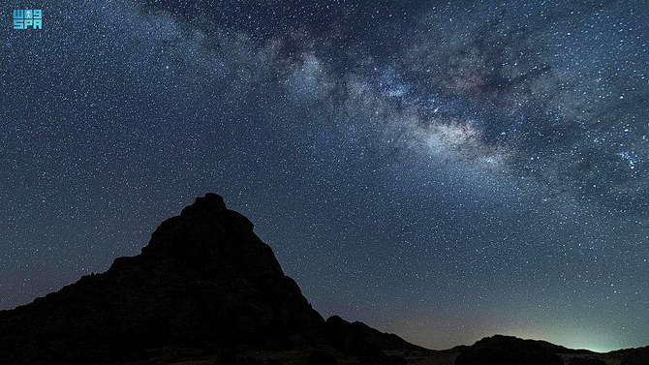
Introduction
Imagine a time when people looked up at the stars and wondered what was beyond. This curiosity led to the development of astronomy,
one of the oldest sciences in the world.
Saudi Arabia has a rich history of astronomy, dating back to ancient times. The country's location in the Arabian Peninsula, with its clear skies and dark nights, has made it a prime spot for stargazing for centuries.
In recent years, Saudi Arabia has made significant investments in astronomy research and infrastructure. The country is now home to some of the world's most advanced astronomical observatories, including the King Abdulaziz City for Science and Technology (KACST) Observatory

Slide 3
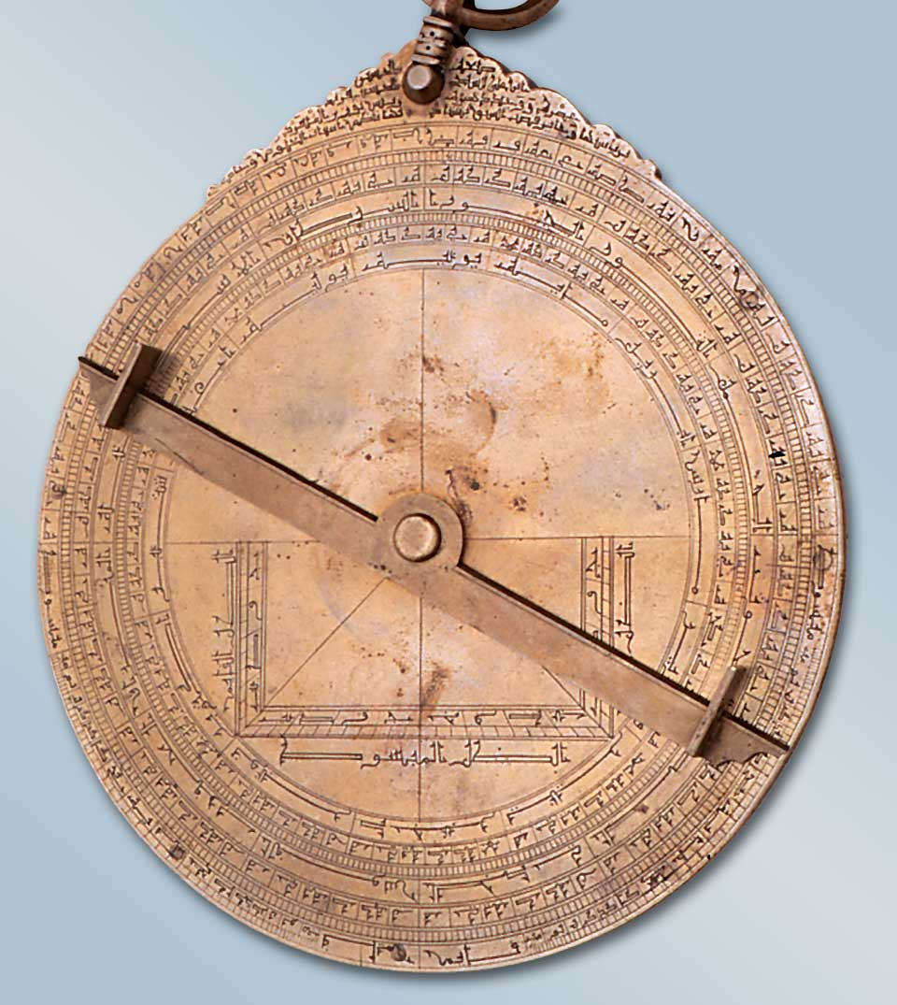
History of astronomy in Saudi Arabia
The Astrolabe
The story of astronomy in Saudi Arabia is a long and fascinating one.
During the Islamic Golden Age (7th-13th centuries), The Arabian Peninsula was home to some of the world's leading astronomers. These astronomers made significant contributions to our understanding of the universe, including developing new instruments and observing techniques.
The earliest known astronomical observations in the Arabian Kingdom date back to the 4th millennium BC. These early astronomers were able to track the movements of the planets and stars, and they developed calendars based on their observations.

Slide 4
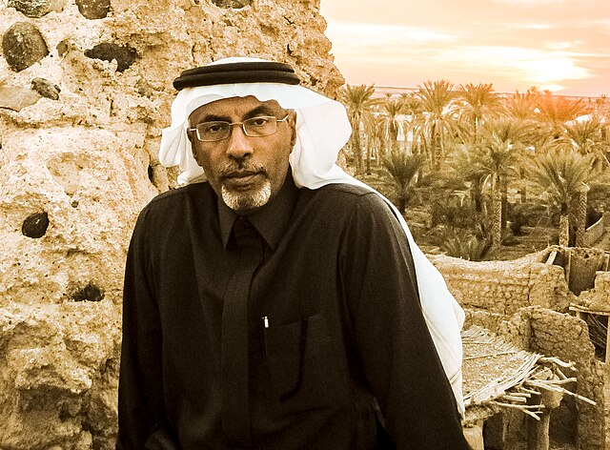
Hassan BaSorra
he was one of the founders of the societal astronomical scientific movement in the Kingdom of Saudi Arabia.
He spent three decades at King Abdulaziz University in Jeddah, during which he witnessed the stages of establishing the Department of Astronomical Sciences. In 1427 AH/2007 AD, Dr. Hassan Basra became head of the Department of Astronomical Sciences, and during his presidency, the first batches of the women’s and men’s departments graduated with master’s degrees in astronomy. During his presidency, the Astronomical Sciences Department Club was established. He was the first to open the department's doors to students of public and private schools in Jeddah, Mecca, and Taif at various stages to visit the planetarium and the astronomical observatory to introduce the younger generations to astronomy. Thus,

Slide 5
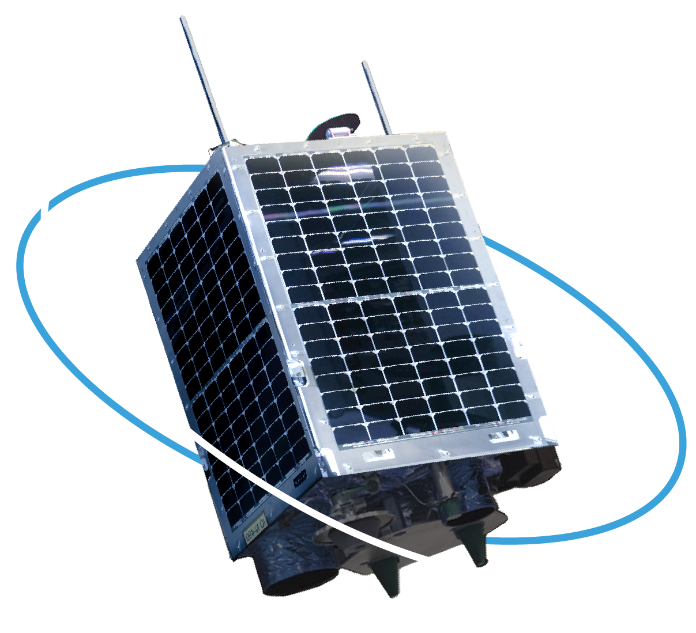
Modern astronomy in Saudi Arabia
Modern astronomy research in Saudi Arabia began in the early 20th century. In 1975, KACST established the country's first astronomical observatory.
Today, Saudi Arabia is home to a number of world-class astronomical observatories, including:
The King Abdulaziz City for Science and Technology (KACST) Observatory
Saudi Arabian astronomers are working on a wide range of astronomical research projects, including:
Studying the formation and evolution of galaxies
Searching for exoplanets
Investigating the physics of the sun and other stars
Moreover, The Saudi satellite Shaheen Sat is part of a new generation of miniaturized satellites, and it carries: a HD camera telescope and a Marine Traffic Automatic Identification System

Slide 6
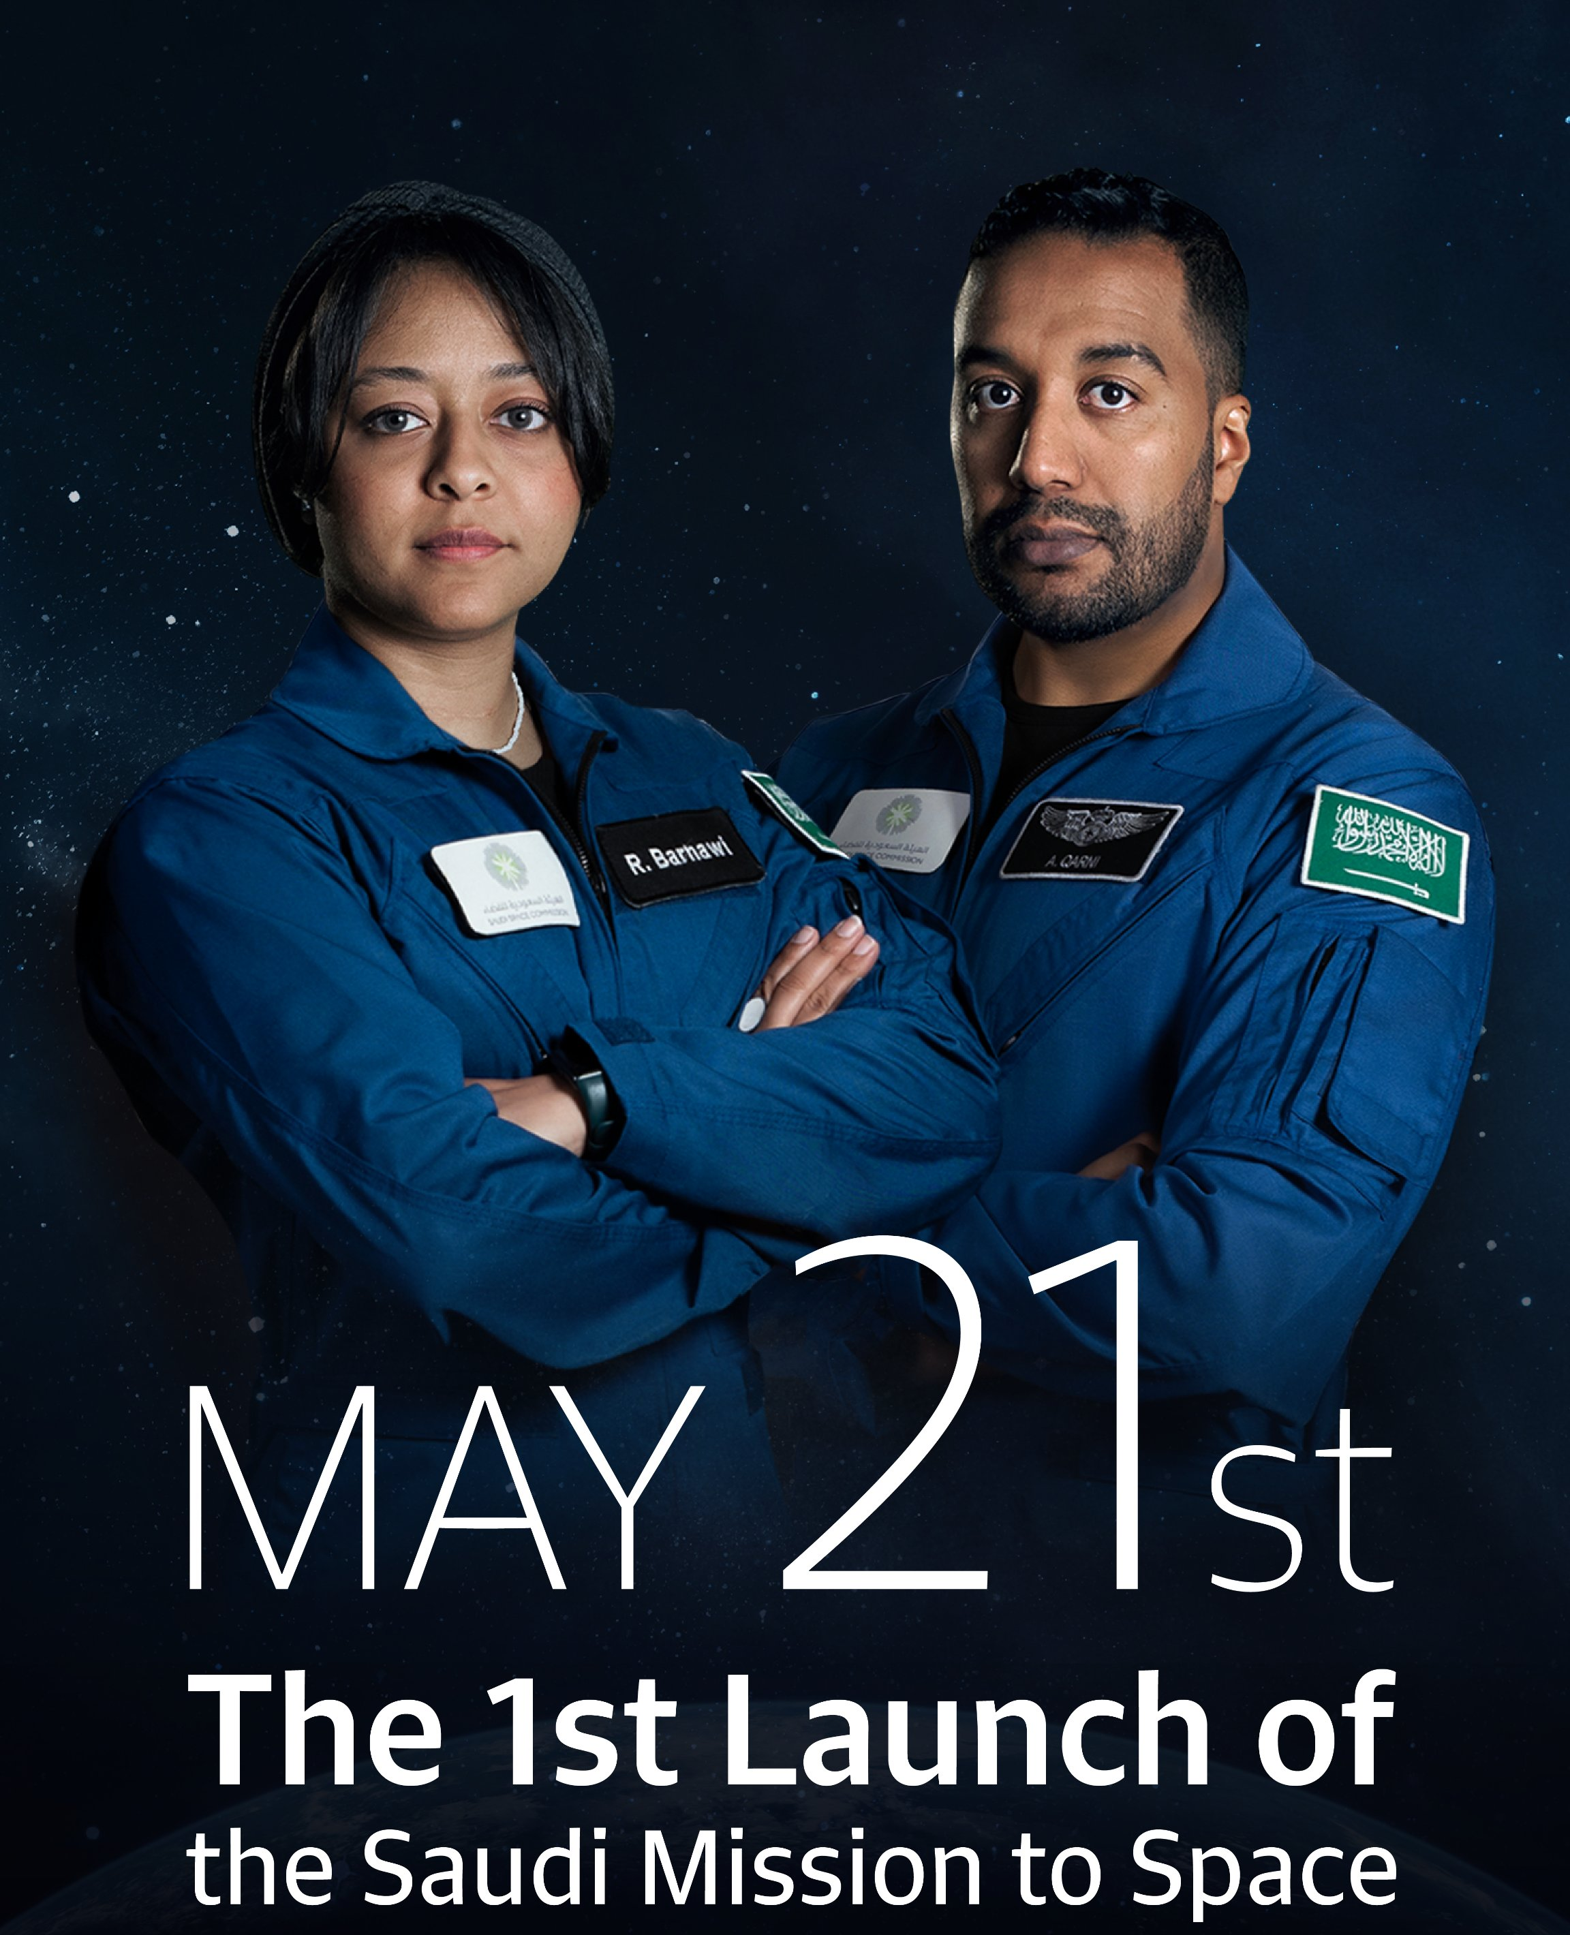
The future of astronomy in Saudi Arabia
In Line With The SAUDI Vision 2030
Saudi Arabia is well-positioned to become a world leader in astronomy research.
The country has significant financial resources, a growing pool of talented astronomers, and some of the world's best astronomical observatories.
In addition, the Saudi Arabian government is committed to supporting astronomy research. In 2017, the government announced a $1 billion investment in astronomy research over the next 10 years.
This investment will support the construction of new astronomical observatories, the development of new astronomical instruments, and the training of new astronomers.

Slide 7
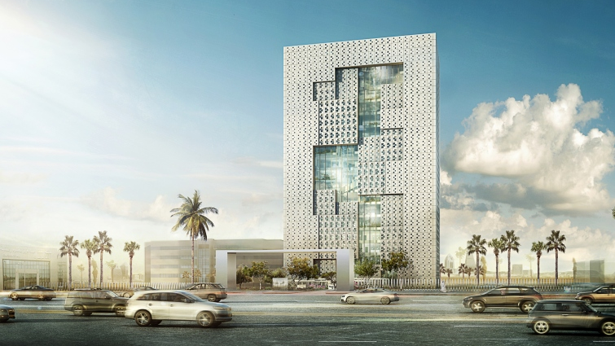
Picture of the King Abdulaziz City for Science and Technology (KACST) Observatory

